Slide 2
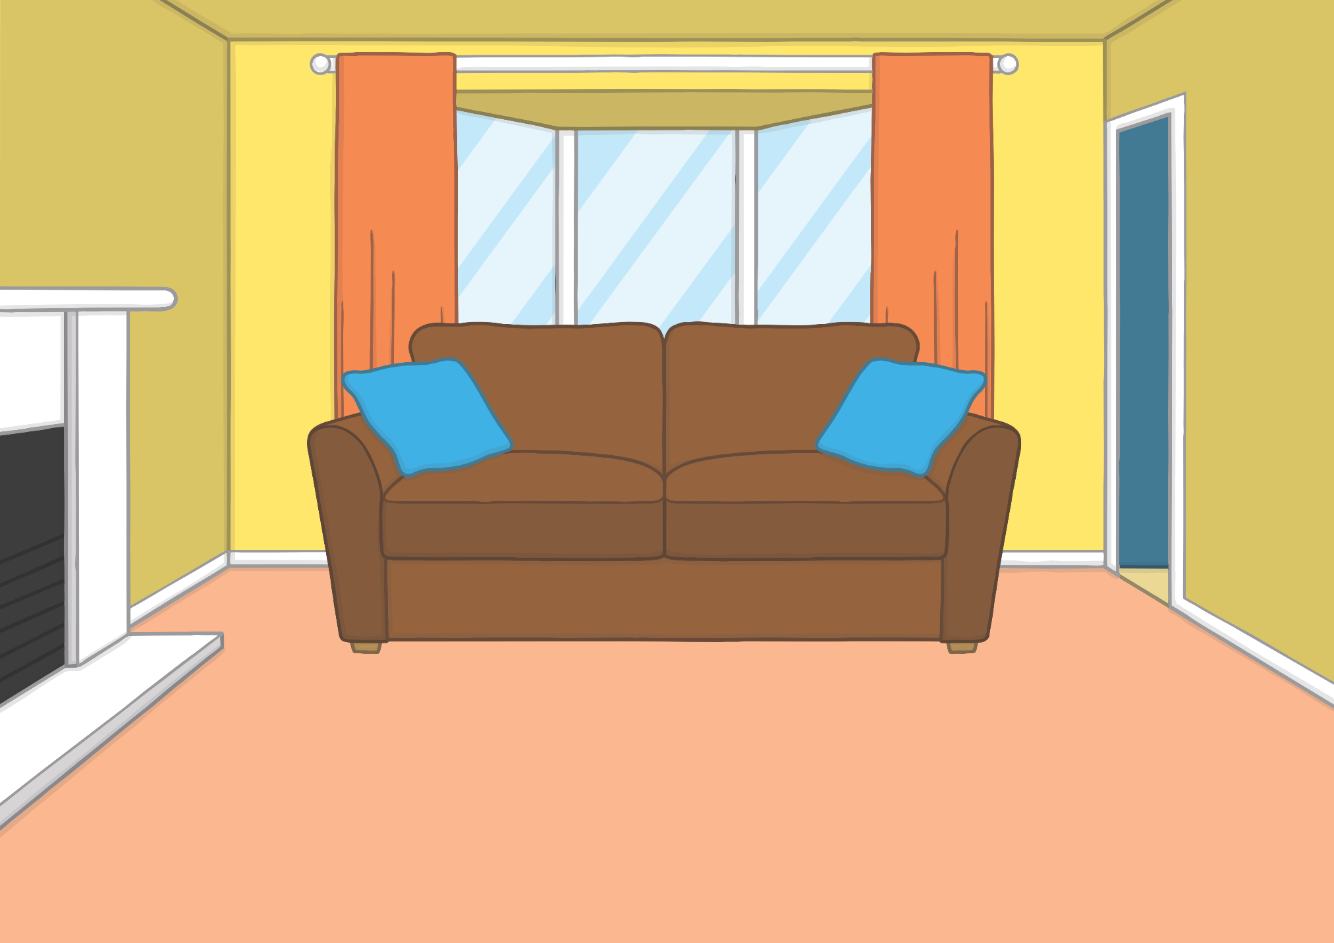


Hello, I’m Kit!
Hi, I’m Sam.
We are twins.

Slide 3
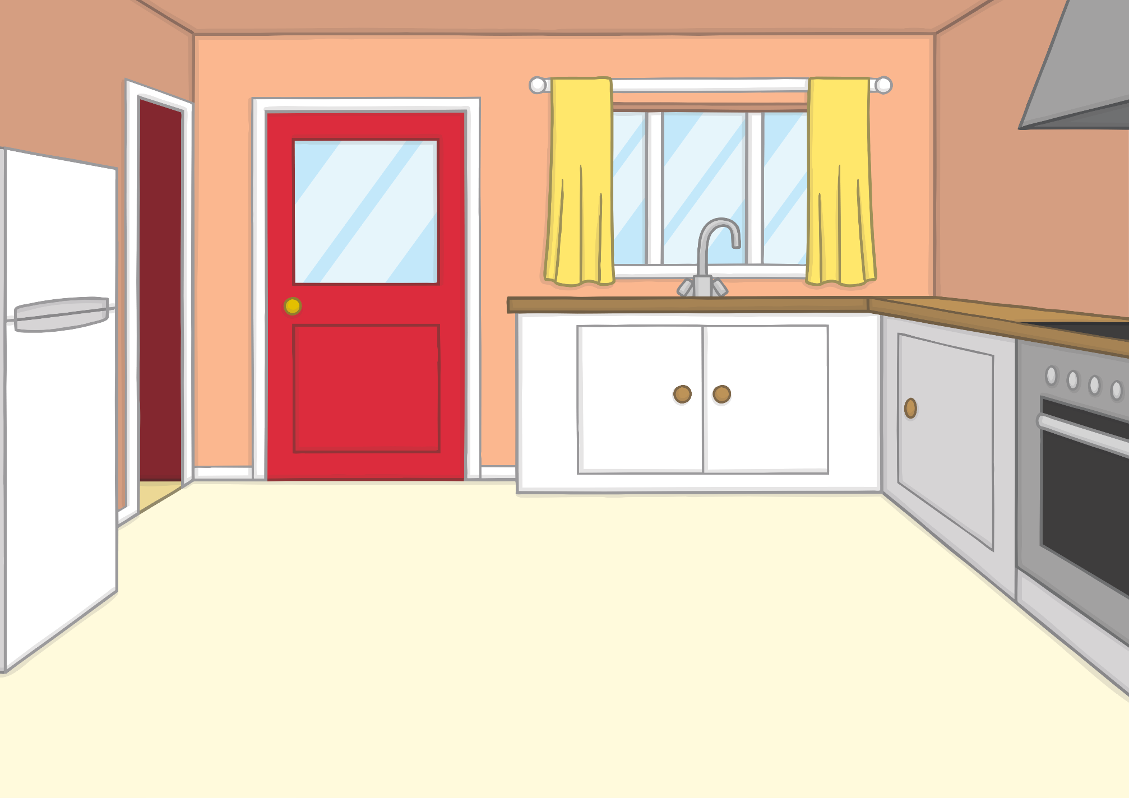

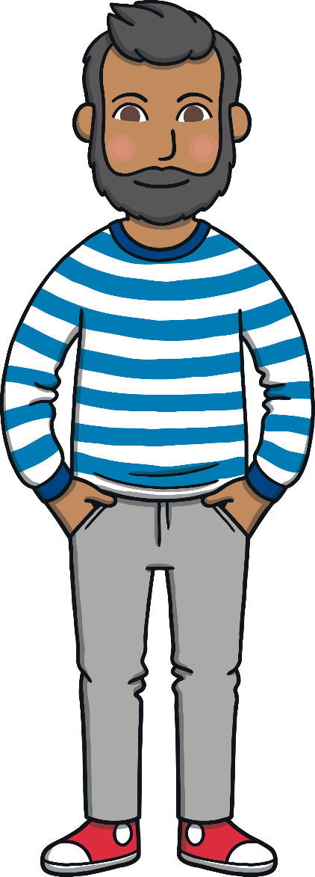
I’m Mum. I am an optician.
Hey! I’m Dad. I work in an office.

Slide 4
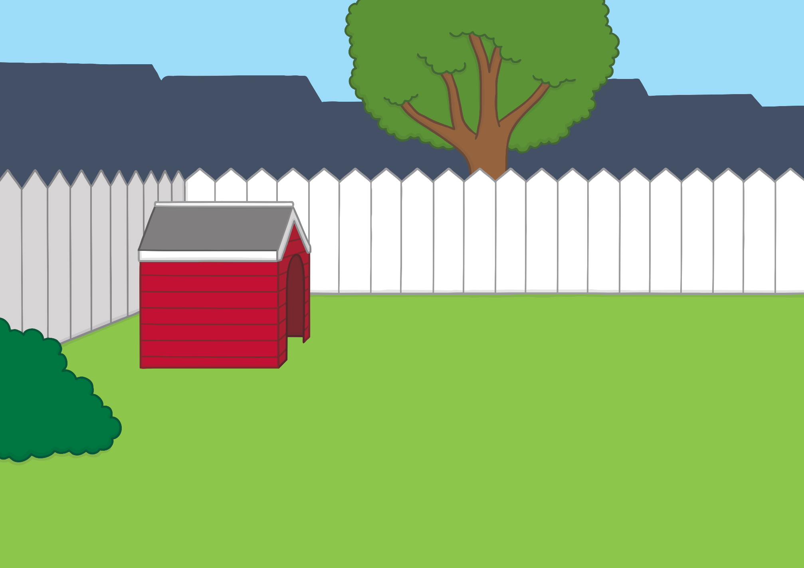




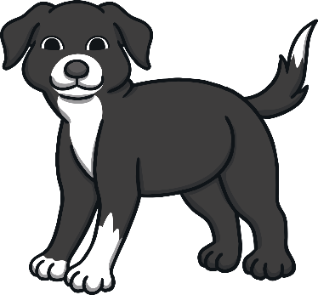
This is our dog, Ben.
Say ‘hello’, Ben!
Woof!

Slide 5
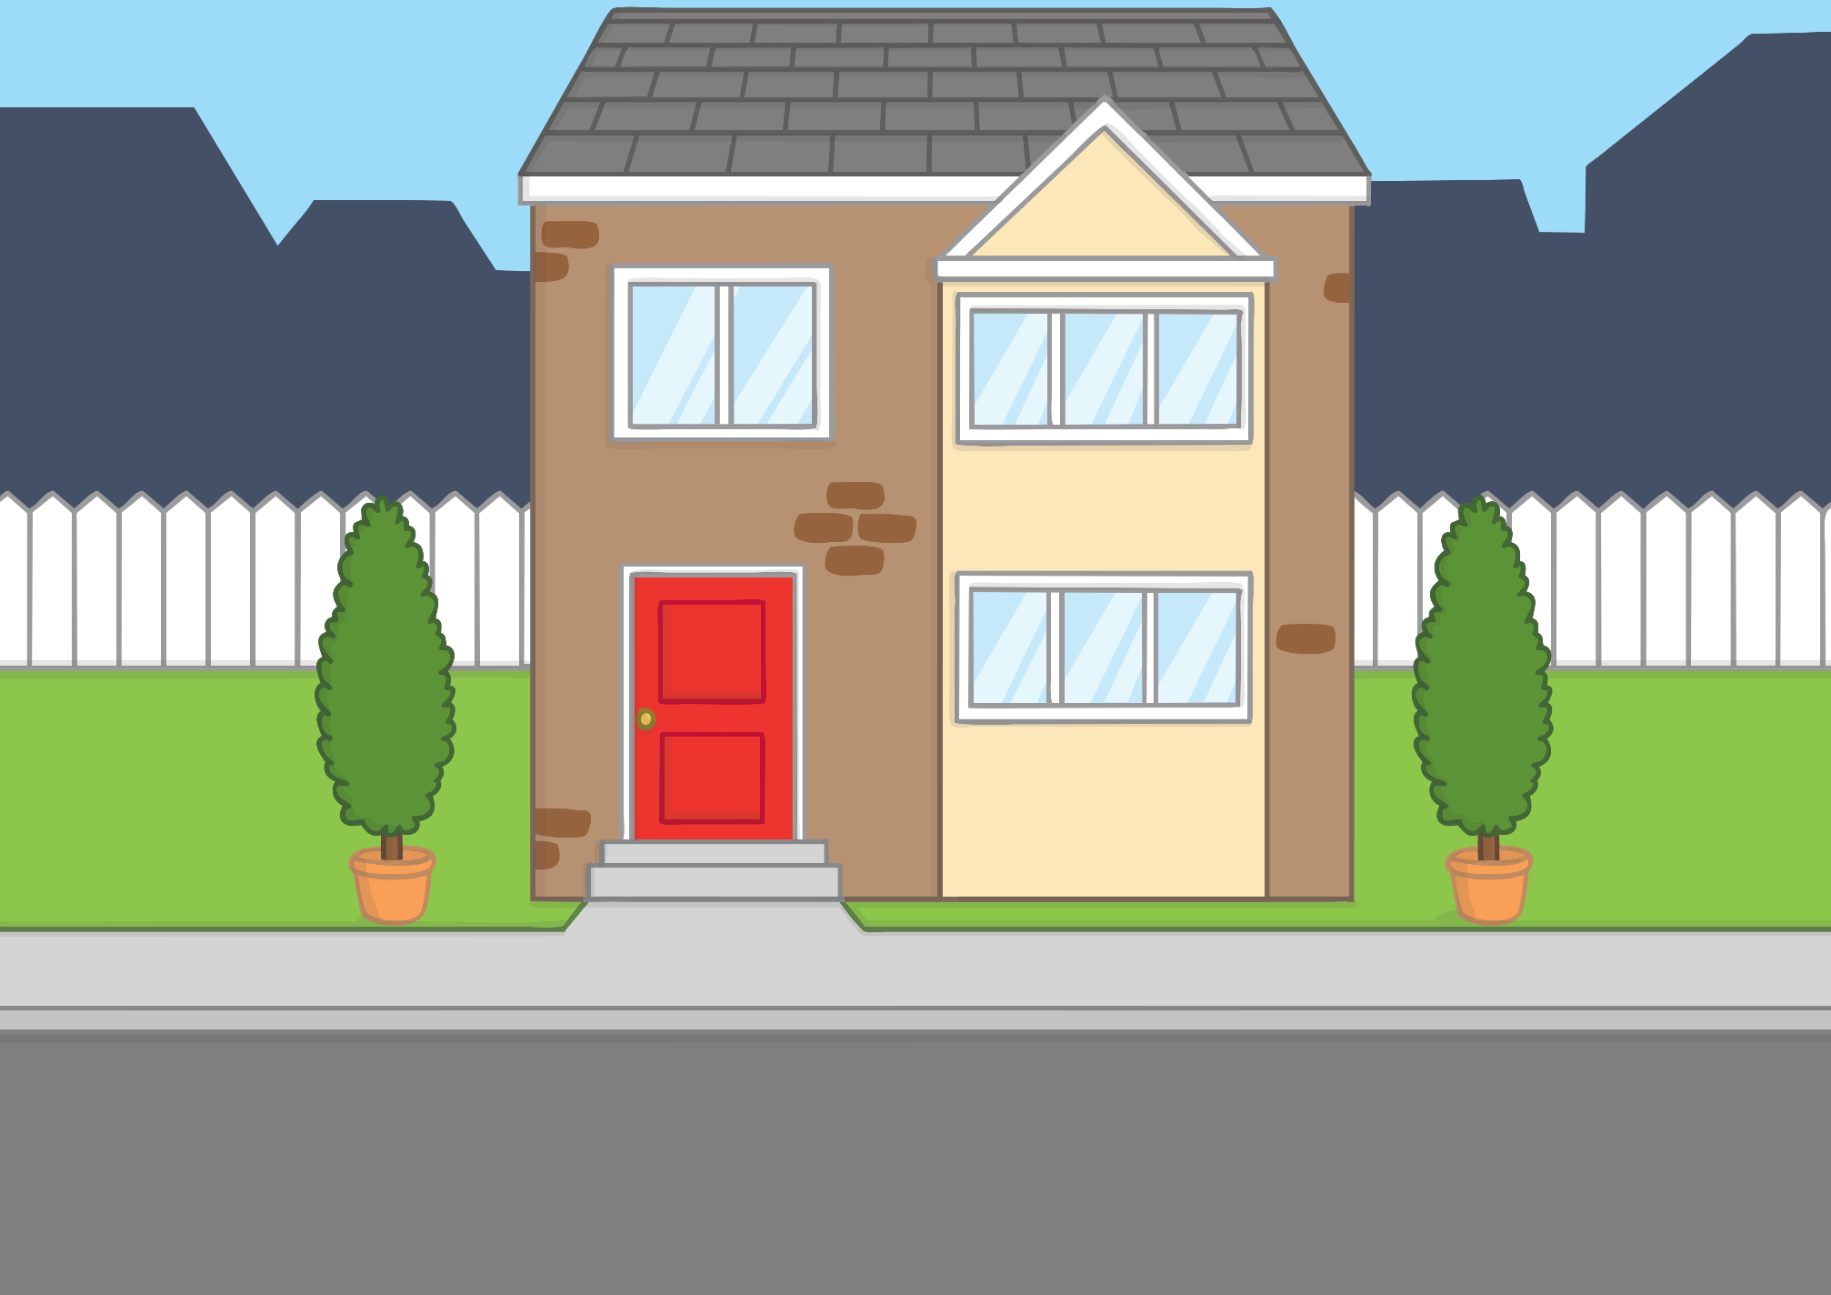


We live in a town.
The countryside is not very far away.
I like to ride my bike, read, and play the drums!
I love
to play cricket and draw.

Slide 6
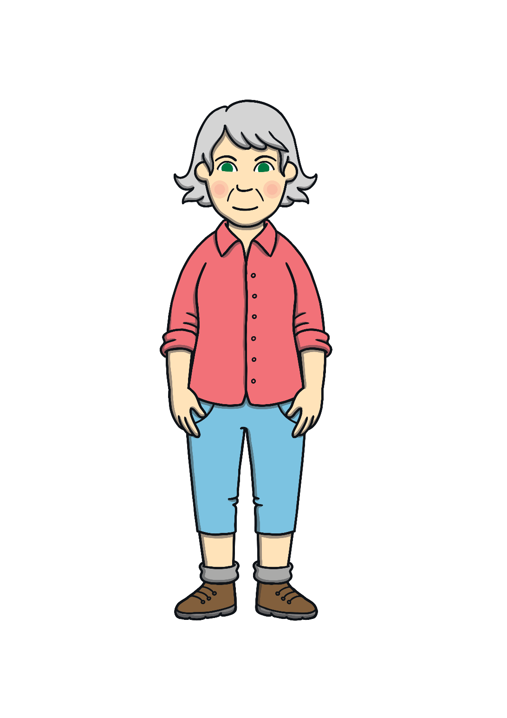
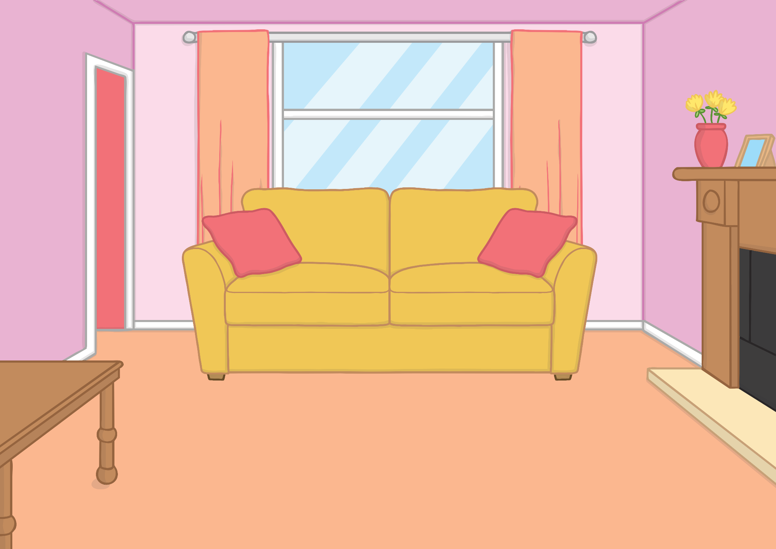

We are Gran and Grandad.
We live in the Highlands!

Slide 7
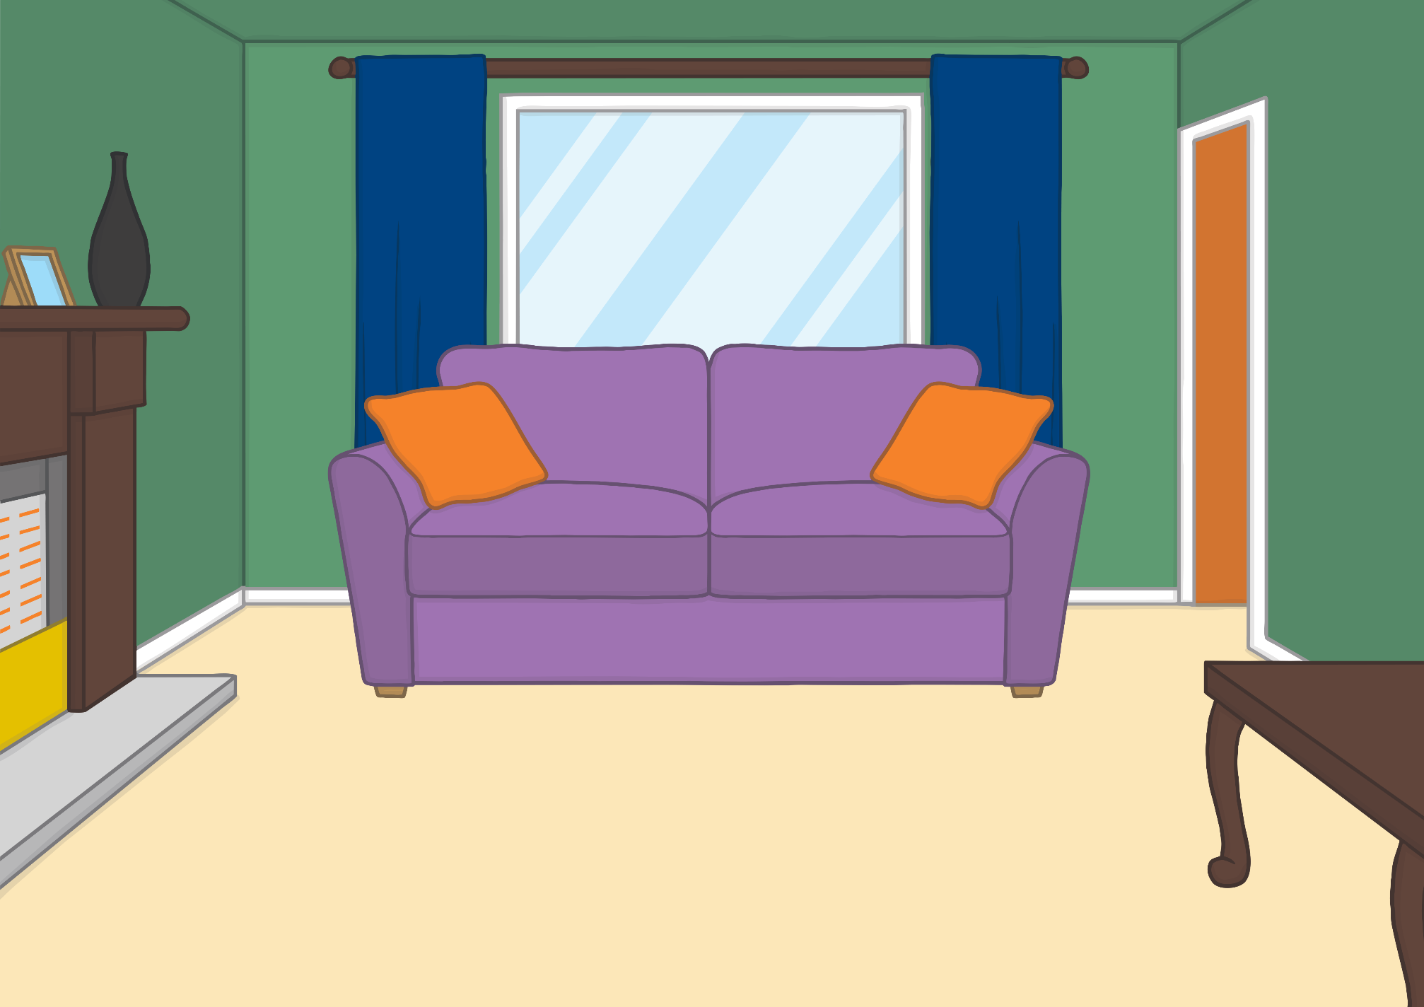


We are Grandma Dadi and Grandpa Dada.
We live in the city.

Slide 8


We can’t wait to have fun with you as you learn to read and write using phonics.
You can join us, and our family and friends, as we share stories and games together.
Sam and I will keep you company all the way.
It’s going to be so much fun!

Slide 9








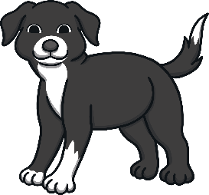
We are the Twinkl Phonics family!

